Slide 1
To replace with my own drawing

Slide 2
CSS342 Data Structures, Algorithms, and Discrete Mathematics (I)

Slide 3
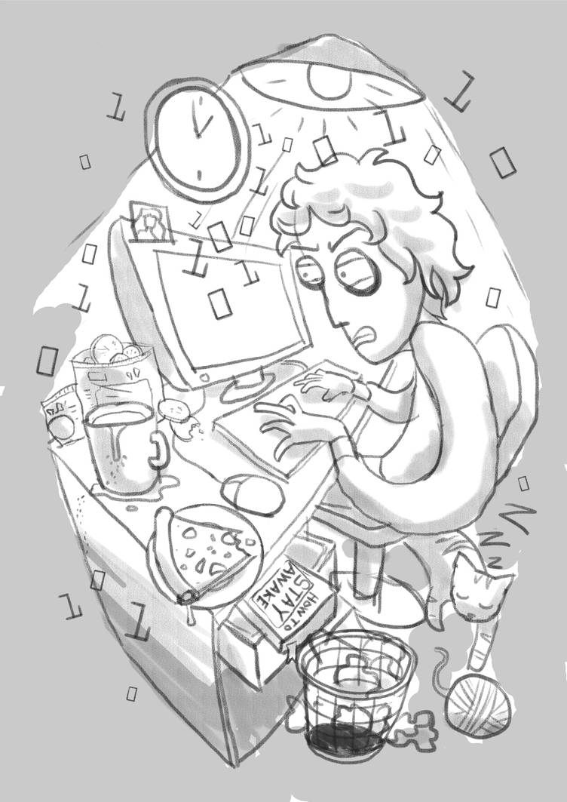
Logistics
Midterm 2 on Wednesday
Quiz 2 will be assigned tonight and due on Thursday
Study Guide

Slide 4
Binary Tree Traverse
Pre-order Traverse:
2
3
4
In-order Traverse:
5
8
1
Post-order Traverse:

Slide 5
Binary Tree Traverse
Pre-order Traverse:
7
5
9
In-order Traverse:
4
6
8
Post-order Traverse:

Slide 6
In-order Traversal
left, root, right
3
1
1
5
2
7
2
7
8
2, 1, 7
2, 1, 7, 3, 8, 5

Slide 7
Inorder(left subtree)
Middle node value
Inorder(right subtree)
Subproblem?
Stopping condition?
Node == null

Slide 8
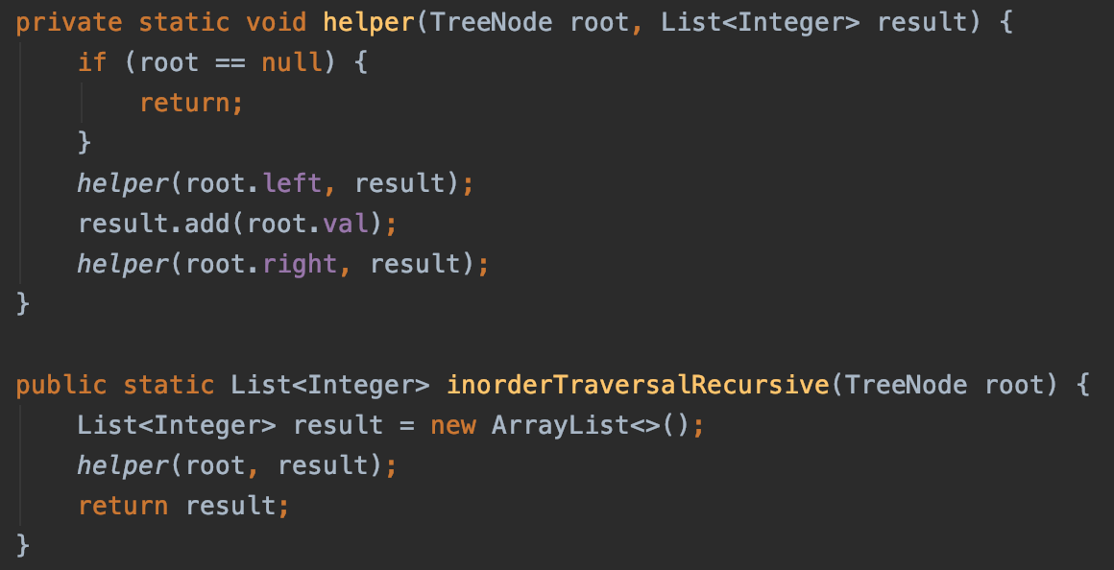
inorder: Left, Root, Right
Recursion

Slide 9
Deeper Dive into The Iterative In-order Traverse
See the other ppt

Slide 10
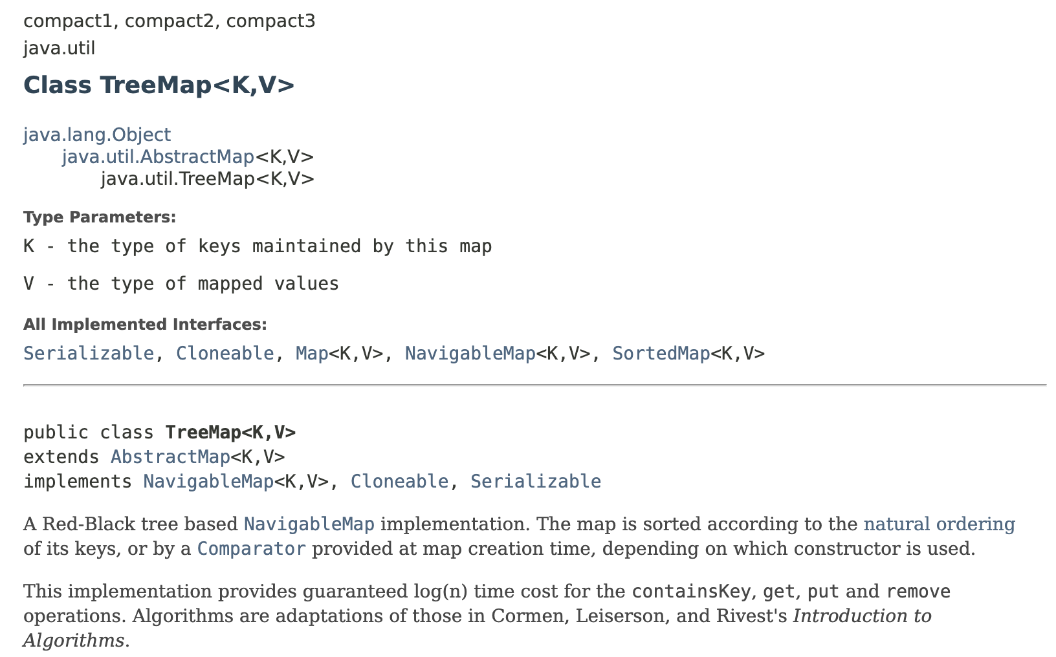
Tree ADT In Java

Slide 11
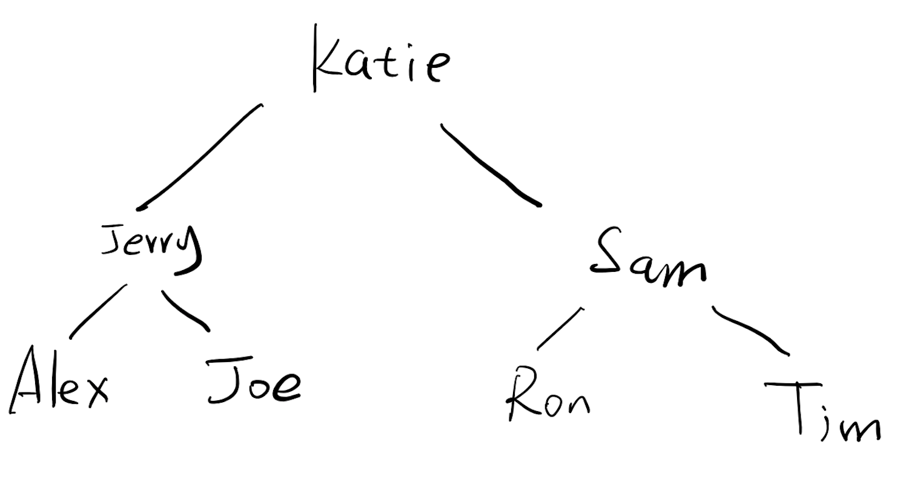
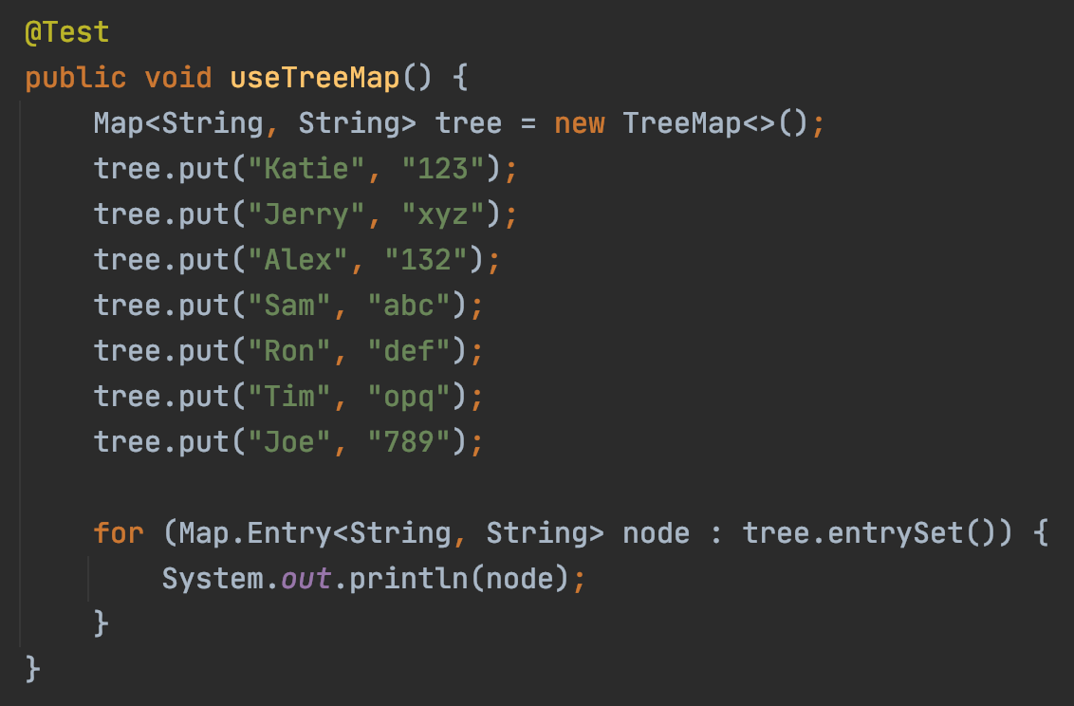
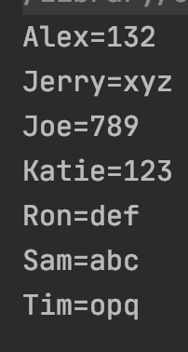
Tree ADT In Java

Slide 12

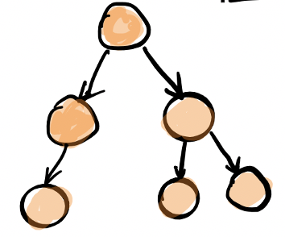
Why binary tree
Maintain ordering efficiently
Allow fast search and insertion

Slide 13
What we have learned so far?
ADT (array vs list)
Stack
Single linked list
Queue
Hash table
Recursion
Search Problem
Sorting
Binary tree
Performance Analysis

Slide 14
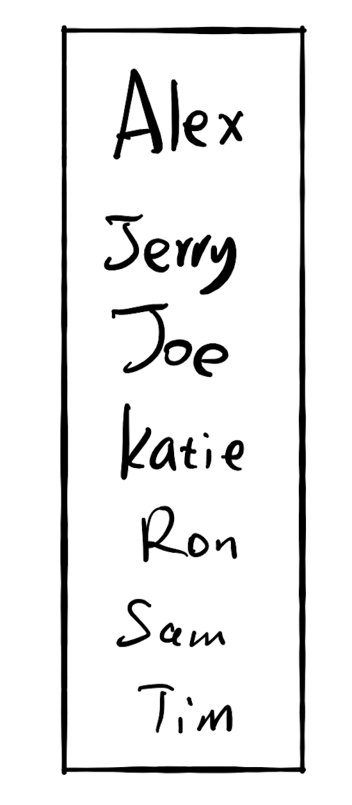
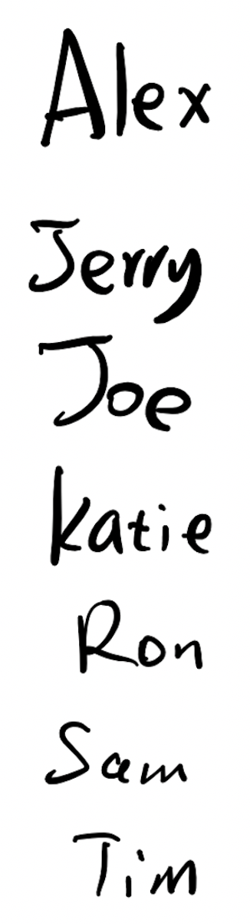
Fast for search
Slow for insertion
Slow for search
Fast for insertion

Slide 15
If there are 10,000 users
Each comparison takes 1 seconds
Search the location:
13s

Slide 16
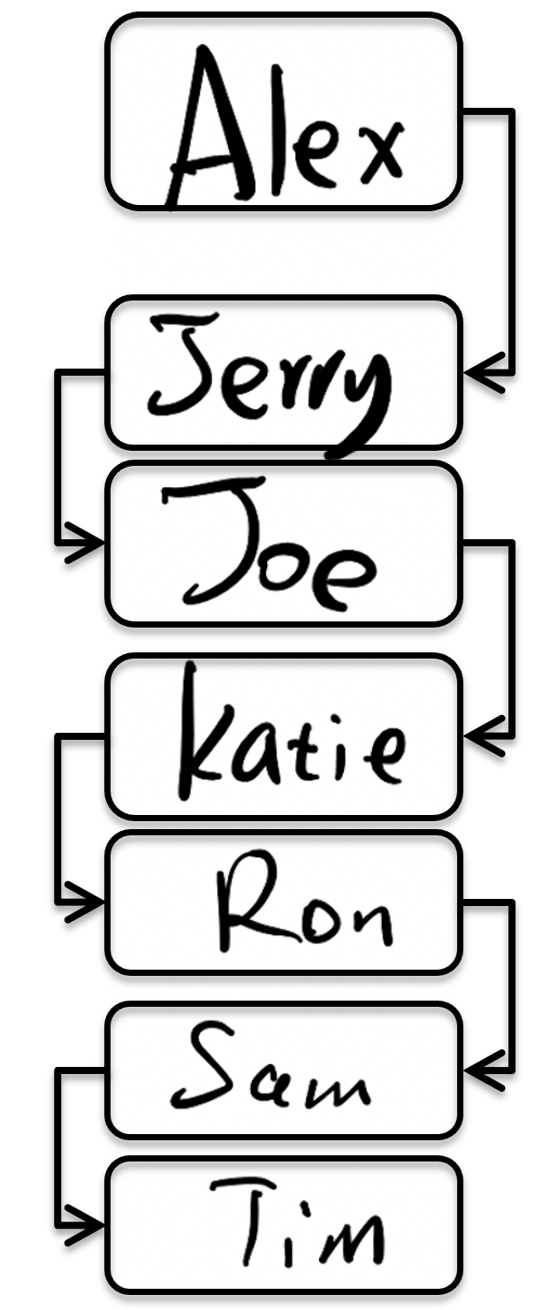
If there are 10,000 users
Each comparison takes 1 seconds
13s
Can we better?
13s
2.78m
fast insertion
Slow insertion
fast insertion

Slide 17
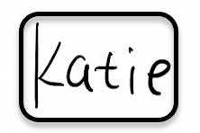
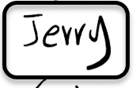
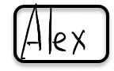
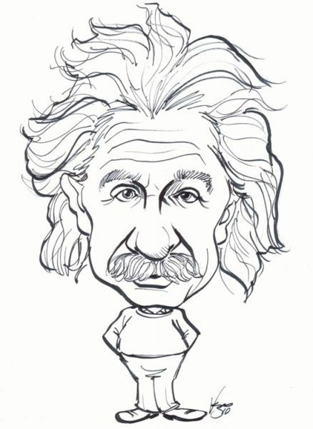

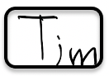
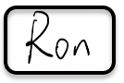
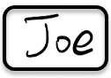

Slide 18
Hash Algorithm

Slide 19
0
3
6
7
9
12
13

Slide 20
0
3
6
7
9
12
13

Slide 21
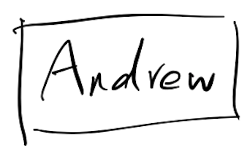
0
3
hashing
6
7
9
12
13
hashing
8

Slide 22
6
value
keyword
“Key value pair”

Slide 23

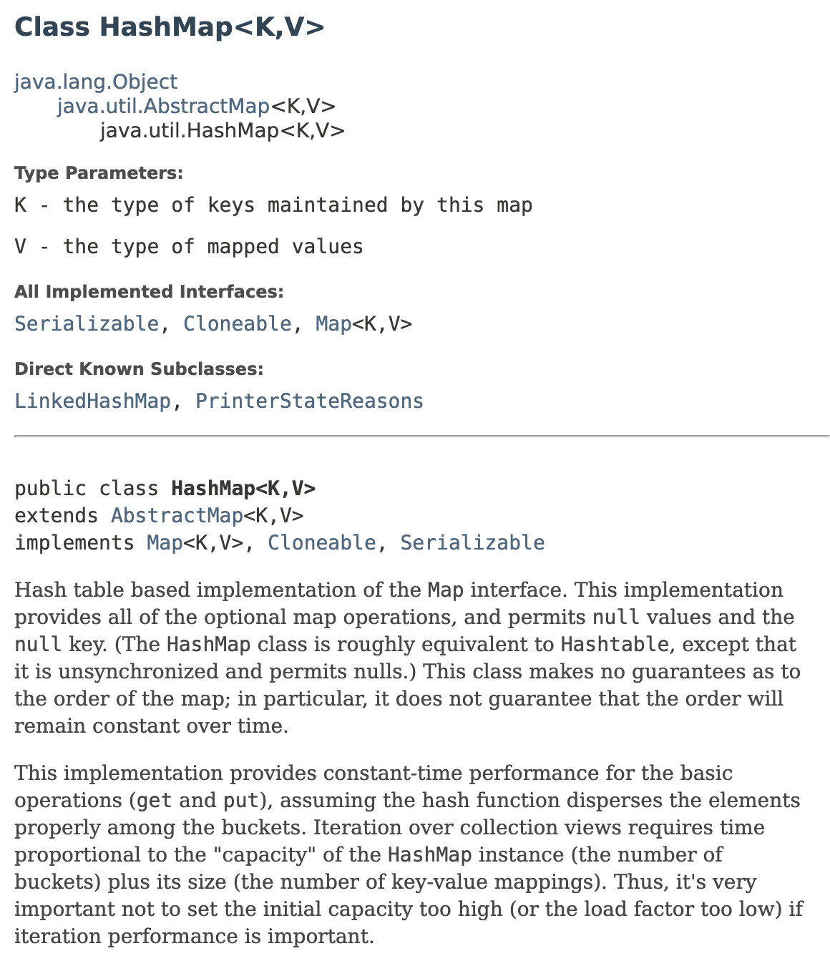
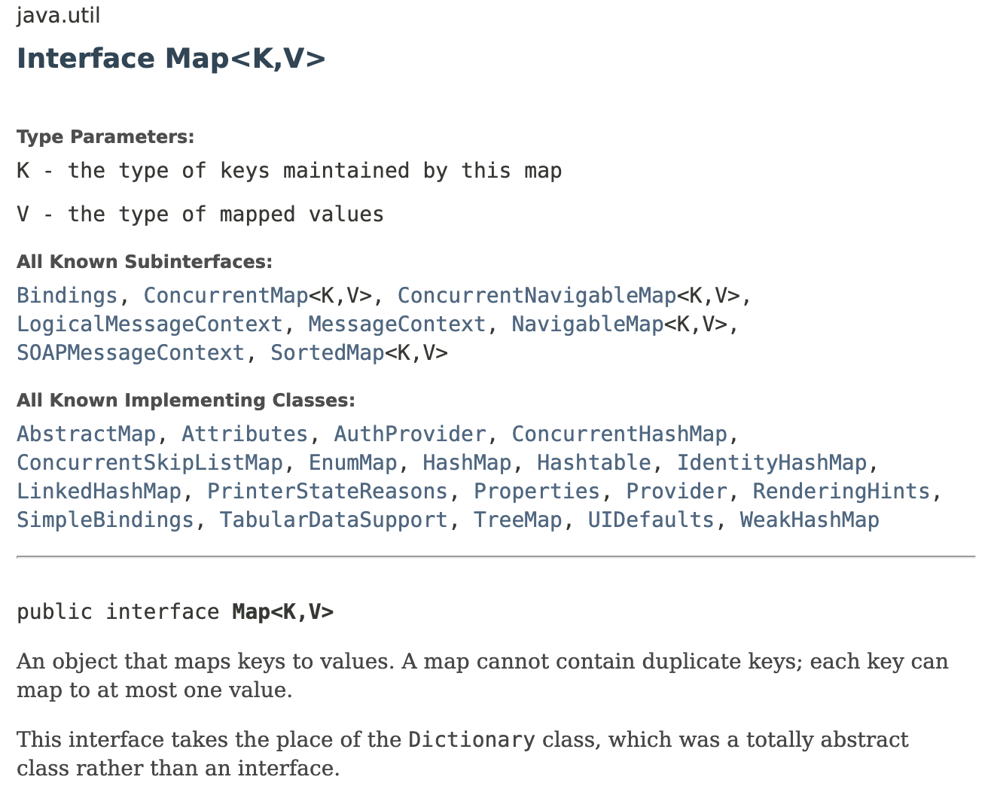
keyword
value
Value related to key

Slide 24
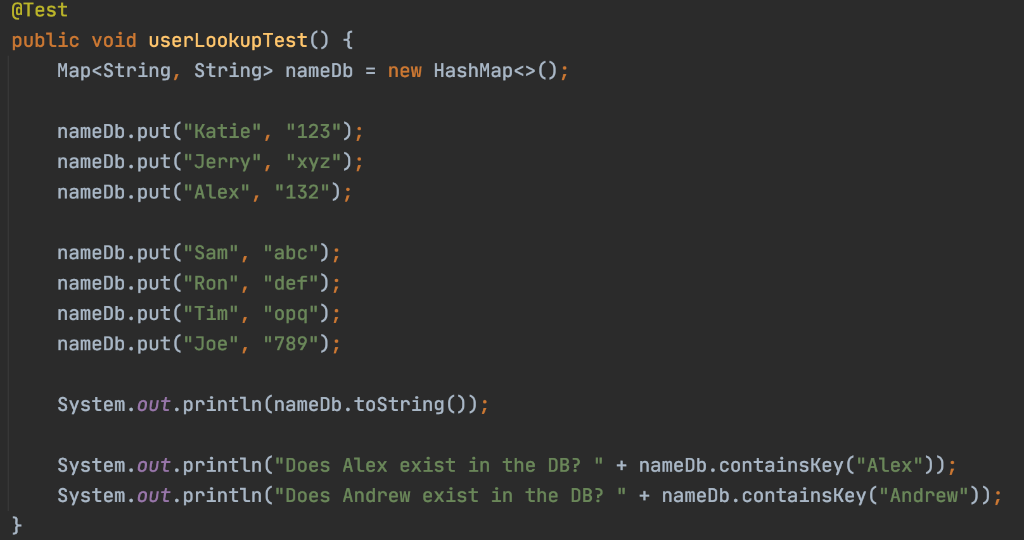

Slide 25
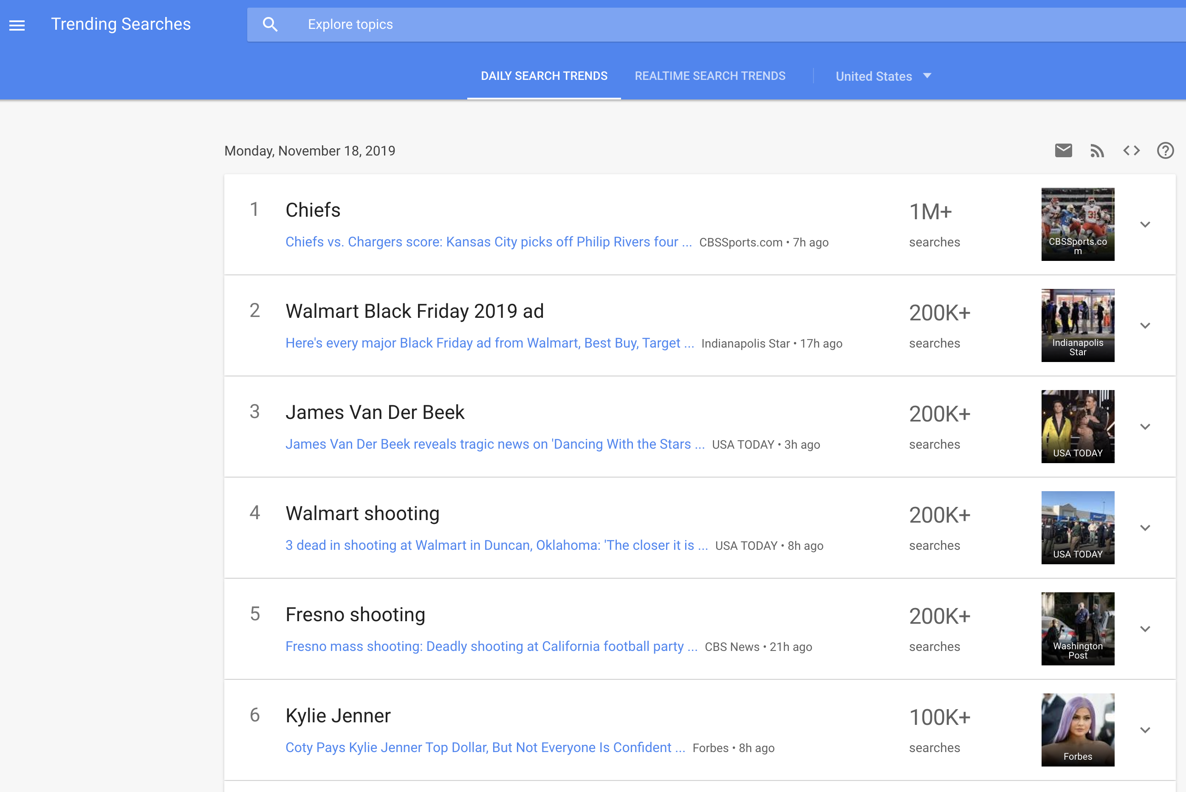
Word Frequency
Given a set of words, count how many times each word appears, and show them in descending order
https://trends.google.com/trends/trendingsearches/daily?geo=US

Slide 26
Word Frequency
Give a text of words
You can't handle the truth! Son, we live in a world that has walls, and those walls have to be guarded by men with guns. Who's gonna do it? You? You, Lieutenant Weinberg? I have a greater responsibility than you can possibly fathom. You weep for Santiago and you curse the Marines. You have that luxury. You have the luxury of not knowing what I know, that Santiago's death, while tragic, probably saved lives. And my existence, while grotesque and incomprehensible to you, saves lives! You don't want the truth, because deep down in places you don't talk about at parties, you want me on that wall. You need me on that wall. We use words like "honor", "code", "loyalty". We use these words as the backbone of a life spent defending something. You use them as a punchline. I have neither the time nor the inclination to explain myself to a man who rises and sleeps under the blanket of the very freedom that I provide, and then questions the manner in which I provide it! I would rather you just said "thank you", and went on your way. Otherwise, I suggest you pick up a weapon, and stand a post. Either way, I don't give a damn what you think you are entitled to!
“A Few Good Men” https://www.youtube.com/watch?v=9FnO3igOkOk
Count how many times each word/sentence appears.
Sort the appearance counts

Slide 27
Word Frequency
Plan (algorithm)
What, you, think, you, are, entitled, to,
Key: word
“what you think you are entitled to”
Value: count
“are”
“entitled”
“think”
“to”
“what”
“you”
1
1
1
1
1
1
2

Slide 28
Word Frequency
Step 1: Count how many times each word occurs
HashMap<String, Integer>
word → number of occurrences
Step 2: Sort the result from step 1 in descending order by value (number of times that word occurs)
number of occurrences → word
TreeMap<Integer, String>
TreeMap: binary search tree with word occurrence number as tree node value

Slide 29
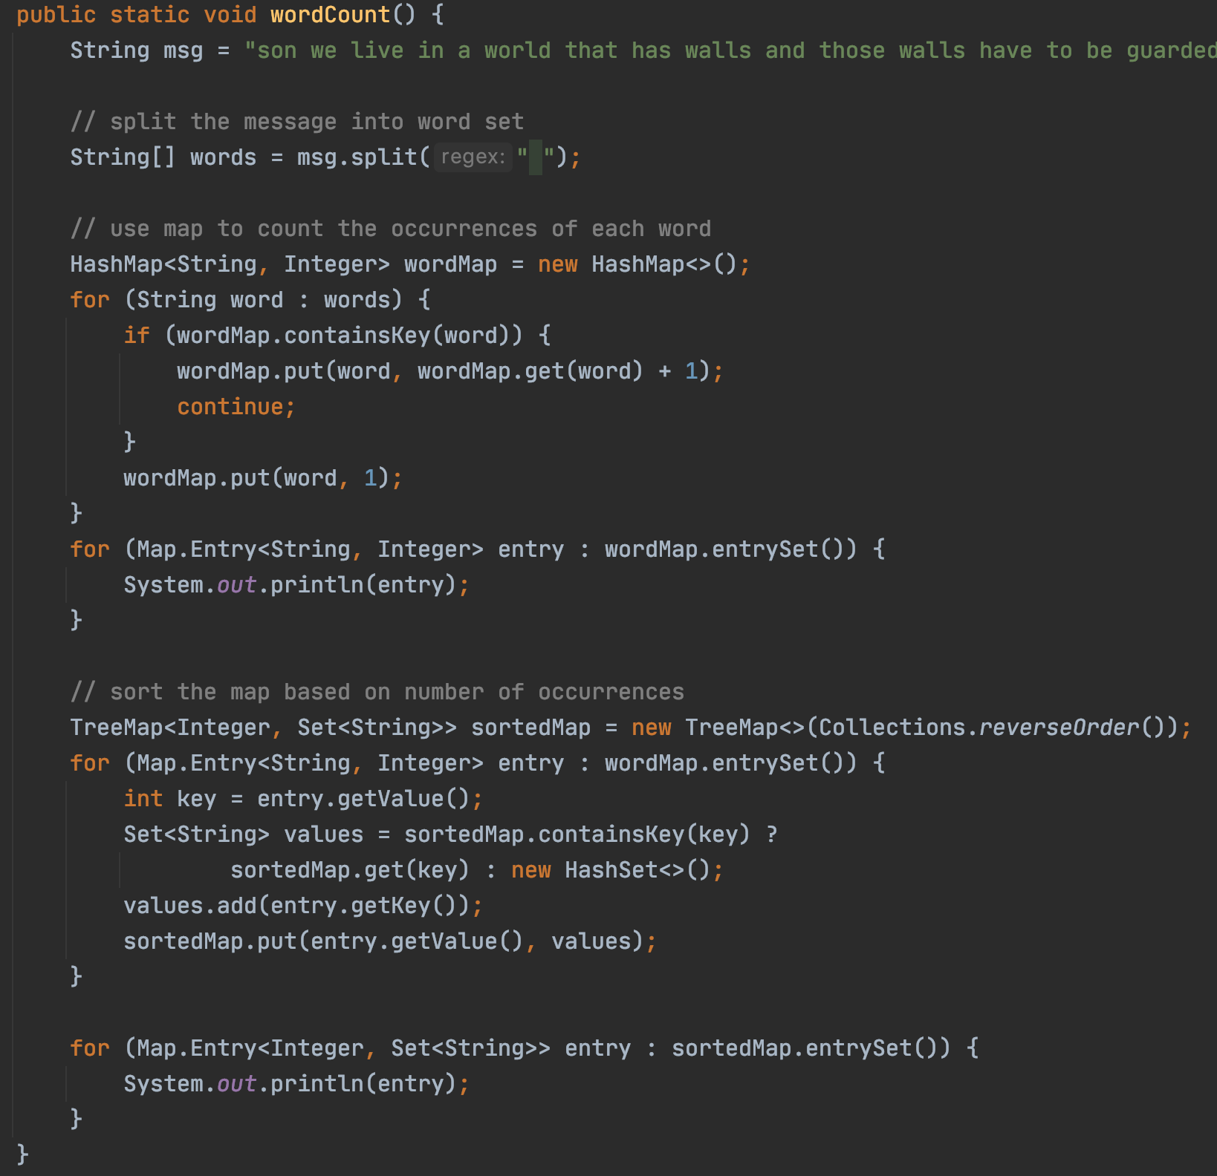
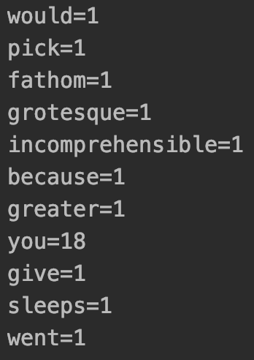
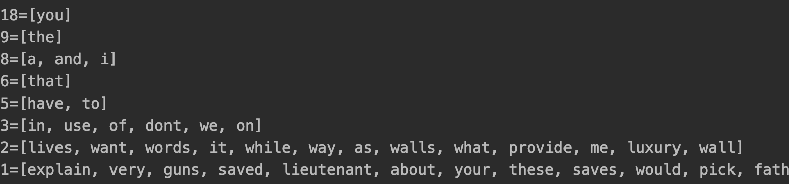
Word Frequency
Count frequency
Sort frequency

Slide 30
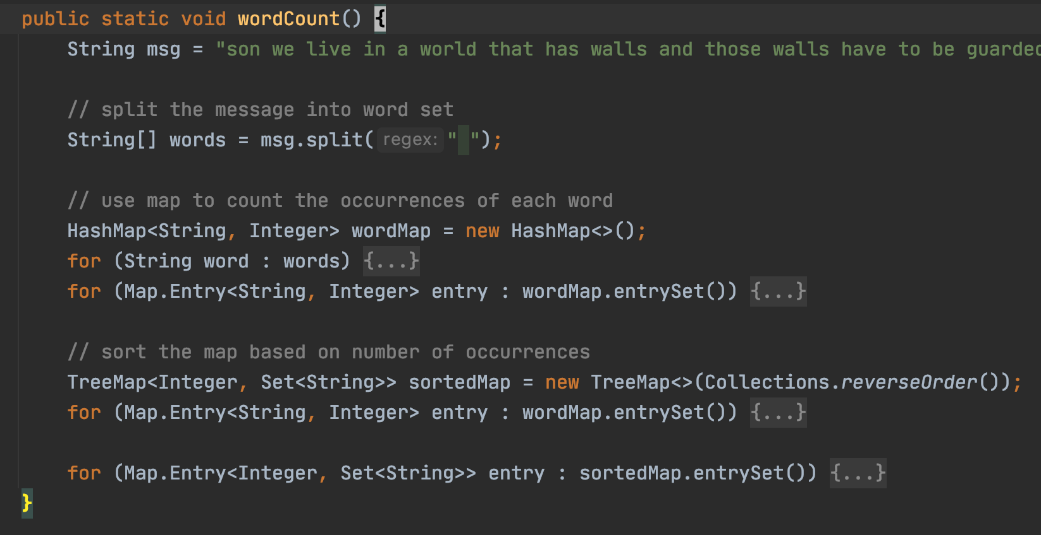
“Take-home” Quiz 2
How would you test this?

Slide 31
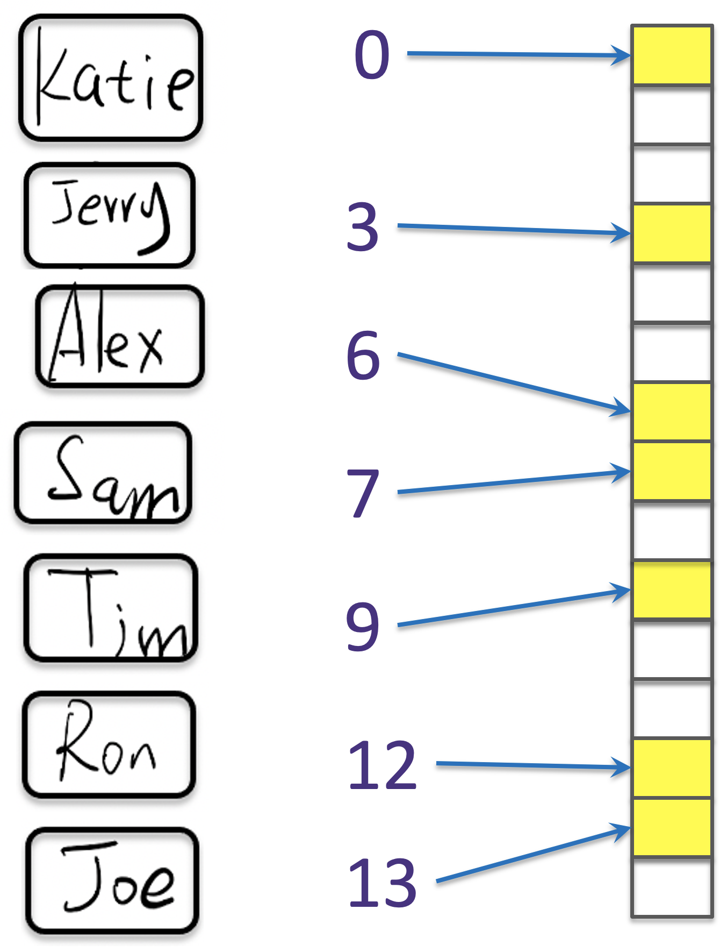
If there are 10,000 users
13s
Each comparison takes 1 seconds
fast insertion
13s
2.78m
Slow insertion
fast insertion
~1s
fast insertion

